Slide 1
RAFT-AF TRIAL
DR. NAEEM QURESHI

Slide 2
AF is the most common adult arrhythmia, associated with substantial patient and health care burden.
Increasing evidence supports early rhythm control for most patients with recently diagnosed AF as well as for those who are symptomatic.
A paradigm shift is evolving in favuor of rhythm control rather than rate control for patients even with new-onset AF.
In the last few years, early intervention with rhythm control in the form of AADs or catheter ablation has shown promising results in maintaining sinus rhythm, and may delay progression of paroxysmal AF to persistent or permanent AF.

Slide 3
CURRENT AF MANGEMENT
Management comprises 3 main domains summarized in the “ABC” scheme of the 2020 European Society of Cardiology (ESC) atrial ﬁbrillation guidelines.
“A” for anticoagulation/avoid stroke.
“B” for better symptom control using rate and rhythm management.
“C” for therapy of concomitant cardiovascular conditions.

Slide 4
AADs typically used for restoration and/or maintenance of sinus rhythm are –
Amiodarone, Dofetilide, Dronedarone, Fecainide, Propafenone, and Sotalol.
Pharmacological rate-control strategies aim to regulate ventricular rate during AF with atrioventricular nodal blocking agents-
mainly Beta-blockers, nondihydropyridine CCB, digoxin, and occasionally Amiodarone.
Rarely, atrioventricular node ablation and permanent pacing may be considered

Slide 5
The current use of rhythm-control therapy is based on evidence generated in key trials originally conducted to compare rhythm vs rate control strategies.
These include the following studies.
PIAF(Pharmacological Intervention in Atrial Fibrillation),
AFFIRM (Atrial Fibrillation Follow-up Investigation of Rhythm Management),
RACE (Rate Control Versus Electrical Cardioversion for Persistent Atrial Fibrillation),
AF-CHF (Atrial Fibrillation and Congestive Heart Failure),
STAF (Strategies of Treatment of Atrial Fibrillation), and
J-RHYTHM (Japanese Rhythm Management Trial for Atrial Fibrillation

Slide 6
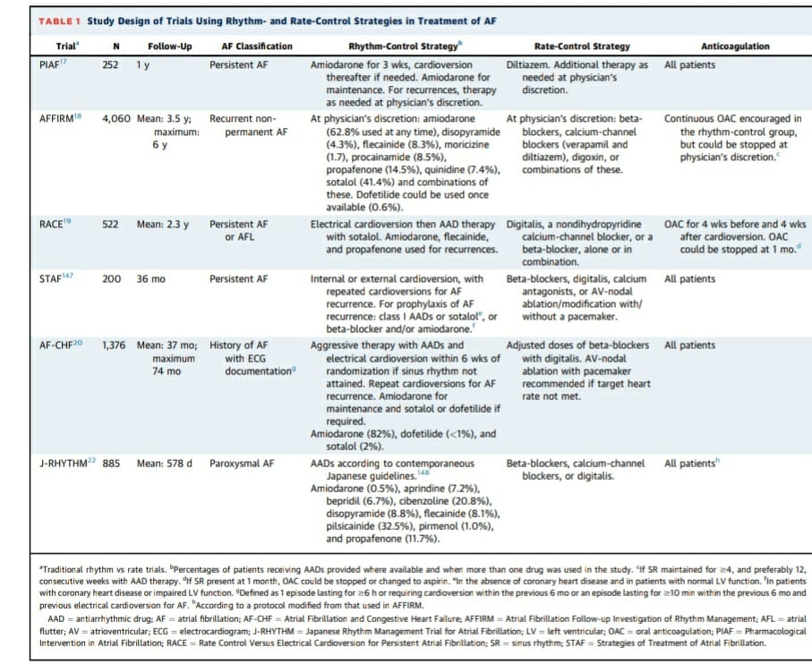

Slide 7
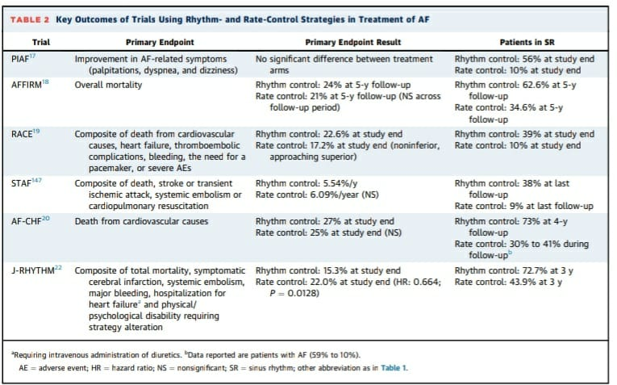

Slide 8
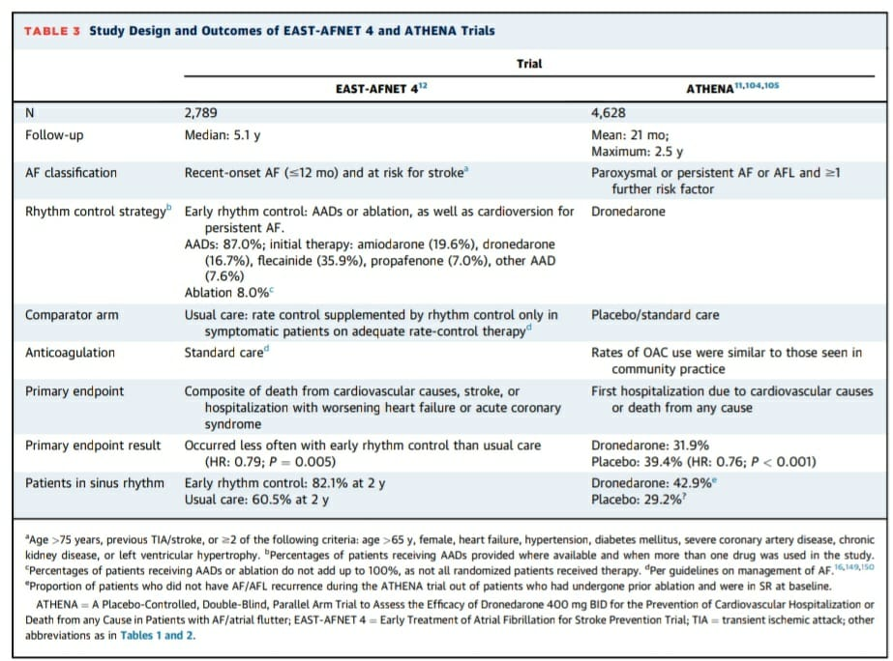

Slide 9
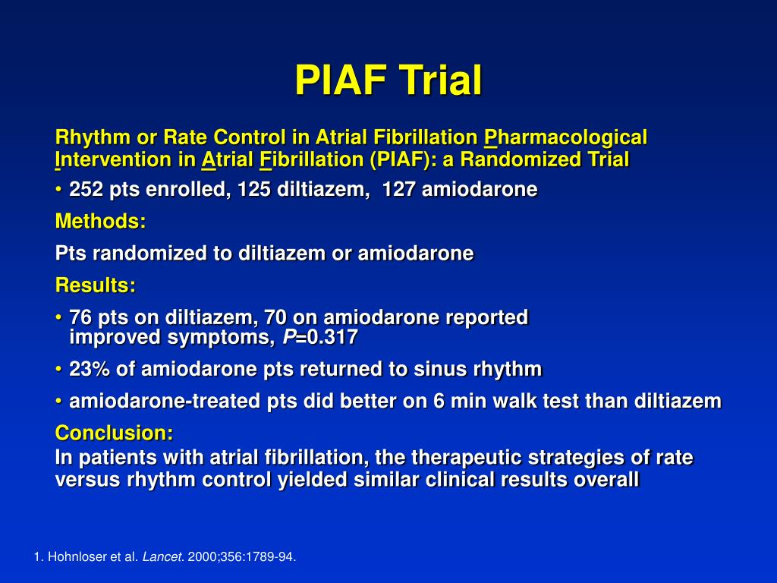

Slide 10
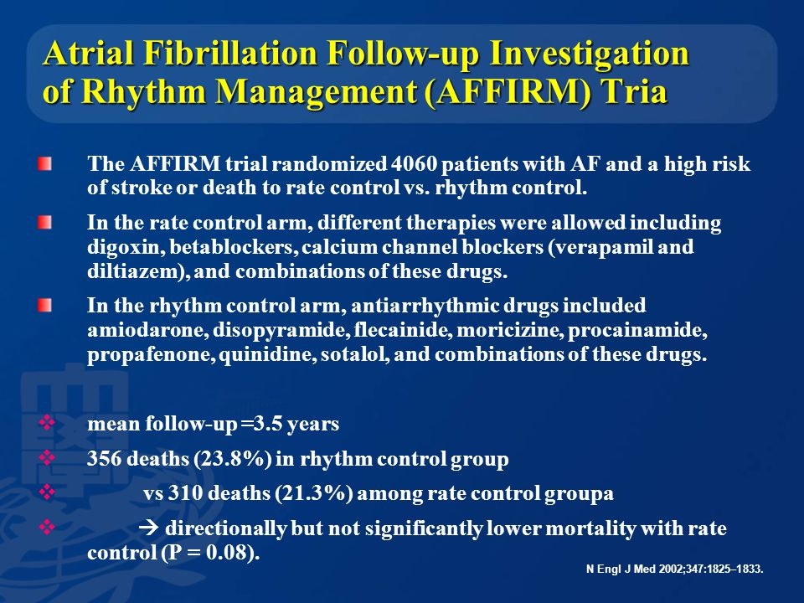

Slide 11
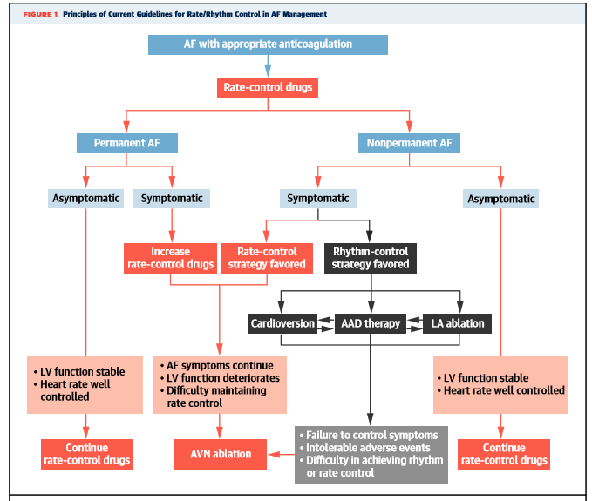

Slide 12
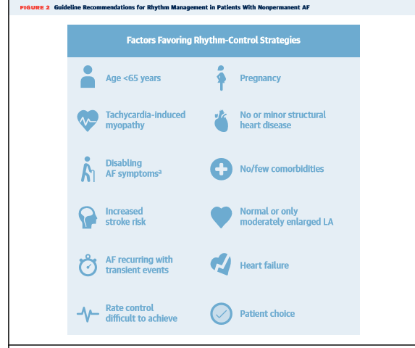

Slide 13
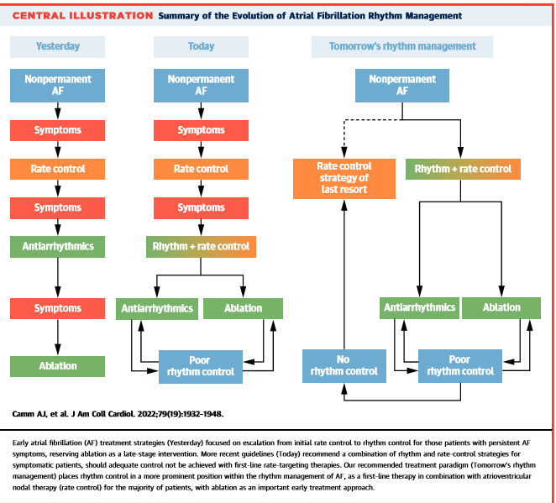

Slide 14
Atrial fibrillation and congestive heart failure are common cardiac disorders associated with substantial morbidity and mortality.
Atrial fibrillation can lead to heart failure, and heart failure can lead to atrial fibrillation, which is present in 10 to 50% of patients with heart failure.
An excessive ventricular rate, a loss of atrial contraction, and an irregular ventricular filling time that is associated with atrial fibrillation may all have negative clinical consequences in patients with heart failure.
Most of the available evidence suggests that such patients with atrial fibrillation have a worse prognosis than those in whom sinus rhythm is maintained and that the presence of atrial fibrillation is an independent risk factor for death

Slide 15
BACKGROUND
Atrial fibrillation (AF) and heart failure (HF) frequently coexist and can be challenging to treat.
Pharmacologically based rhythm control of AF has not proven to be superior to rate control.
Ablation-based rhythm control was compared with rate control to evaluate if clinical outcomes in patients with HF and AF could be improved.

Slide 16
HYPOTHESIS
PRIMARY HYPOTHESIS
Cathetor ablation based AF- rhythm control as compared with rate control reduces the primary outcome of all causes mortality and and HF events in patients with AF and HF of either LVEF<45% or LVEF > 45%.
SECONDARY HYPOTHESIS
Cathetor ablation based AF rhythm control as compared to rate control reduces the primary outcome of of all cause mortality and HF events in patients with AF and HF of LVEF < 45%.
Cathetor ablation based AF rhythm control as compared to rate control reduces the primary outcome of all causes mortality and HF events in patients with AF and HF of LVEF > 45%.

Slide 17
STUDY DESIGN
Parallel, randomized controlled trial :
Eligible patient were randomly assigned in 1:1 ratio to receive
Ablation based rhythm control
Rate control
Stratified by center, LVEF ( < 45%, > 45% )and AF type.
21 center from Canada, Sweden, Brazil and Taiwan
PROBE ( prospective Randomized Open Blinded End point ) design.
Trial interventions :
Ablation based rhythm control-one or more ablation for AF with pulmonary vein isolation +_ addition lesions, AAD used for AF recurrence after more than one ablation procedure.
Rate control- AV nodal blockers+_ ablate and bi V pace targeting a resting HR < 80 bpm and 6 minute walk HR < 110 bpm

Slide 18
Key inclusion criteria
Patient with one of the following AF type ( atleast one ECG of AF )
1.High burden paraoxysmal AF - >4 episodes of AF in last 6 months
and atleast one episode > 6 hour and less than < 7 days.
2. Persistent AF 1- AF episodes < 7 days but requires cardioversion
3. persistent AF 2- atleast one episode of > 7 days but not > 1 year.
4.long term persistent AF- atleast one episode > 1 year but not >3 Y
Optimal therapy for heart failure of atleast 6 weeks.
Heart failure with NYHA class II or III symptoms.
Either impaired LV function ( LVEF < 45%) or preserved ( LVEF > 45%) determined within 12 months prior to enrollment.
Suitible candidate- > 18 years
NT pro BNP > 600 ,if hospitalized in last 9 month
> 900 if not hospitalized

Slide 19
EXCLUSION CRITERIA
LA Dimension > 55 mm
Severe aortic or mitral valve disease.
Life expectancy of < 1 year

Slide 20
Primary and secondary outcome measure
PRIMARY OUTCOME- composite of time to death or HF events
HF events are defined as an admission to health care facility >24 hours or clinically significnat worsening HF leading to administration of IV diuretics and increase in chronic HF therapy in emergency department.
SECONDARY OUTCOME-death , HF event , change in LVEF, NT pro BNP , six minute walk distance and quality of life at 12 and 24 months.
The primary and secondary outcomes were evaluated in patients with LVEF < 45% and > 45%.
Subgroup analysis ( not stratified)- sex , diabetes, hypertension, underlying heart disease, NYHA class.

Slide 21
TRIAL PROGRESS
Initial sample size was calculated to be 600 ( 300 per study group).
30 % relative risk reduction of primary outcome
Annual event rate > 17% in rate control group, 11.9% in rhythm control group
Loss of follow up 2%, cross over 2%.
In January 2018 recruitment was stopped due to-
lower than expected enrollment rate
lower than expected annual events
perceived futility, based on data of 363 patients followed for a median of 19.5 months .

Slide 22
Preablation procedure to be followed-
All AAD were discontinued for 5 half lives and amiadrone for 6 weeks before the procedure.
Antiarrhythmic medicine permitted for 4-6 weeks postablation.
AAD used were Amiadrone or dofetilide in patient with reduced EF and amiadrone or sotalol in patient with preserved EF.
For patient assigned to rate control , beta blockers, CCB( if not CI) digitalis and combination,
If heart rate not controlled with medication AV node ablation with biventricular pacing was recommended.
All patients in both groups were recommended to be maintained on oral anticoagulation indefinetly, irrespective of treatment assignment or outcome.

Slide 23
At baseline and at each follow up visit , all patient had a 12 lead ECG, 6 minute walk test, medication evaluation and quality of life assessment with Minnesota living with HF questionnaire.
For all patients, rhythm status was determined using the 12 lead ECG performed at each follow up, LVEF was collected at the annual follow up.
All patients were followed at 2, 4 and 6 months and than every 6 months for a minimum of 2 years or until the end of follow up.

Slide 24
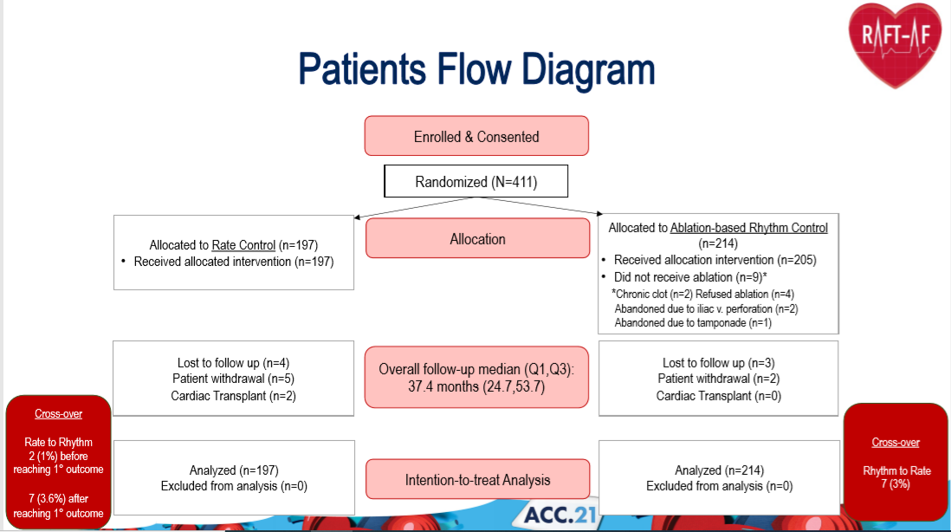

Slide 25
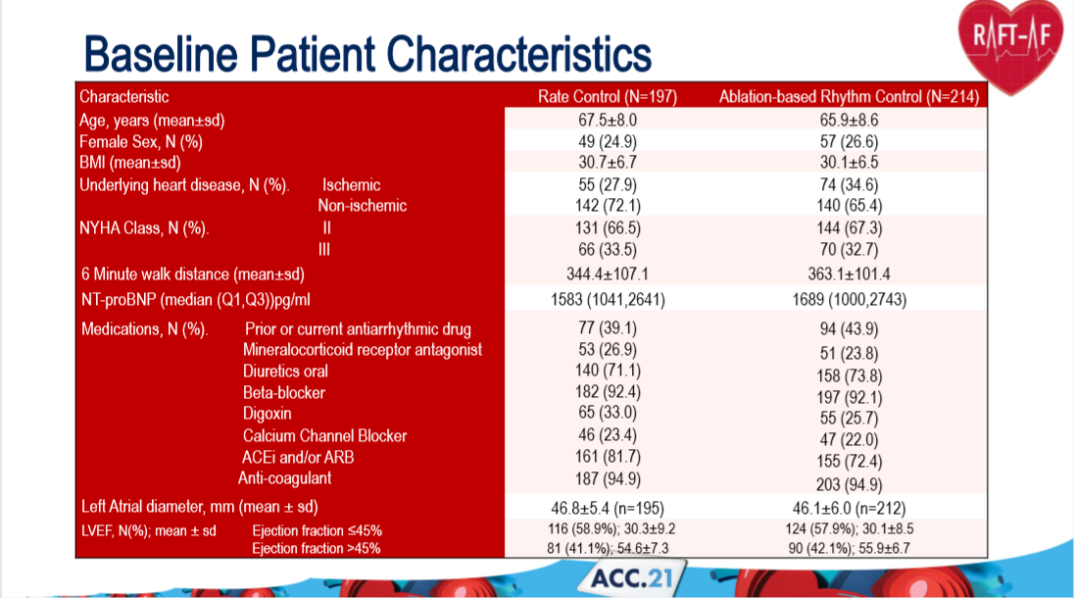

Slide 26
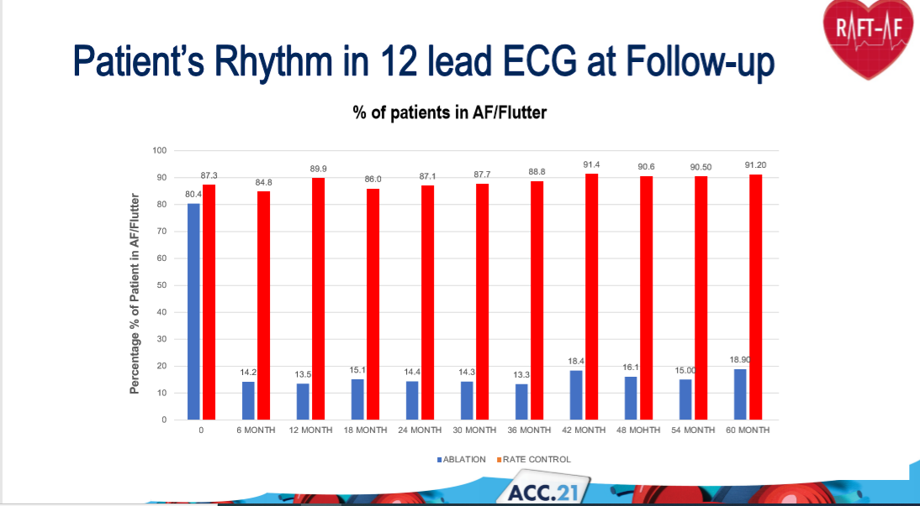

Slide 27
Follow up
Median follow up was 37.4 months,
out of 214 patients, in catheter ablation group
205 had catheter ablation, ( 128 had 1 ablation, 69 had 2 procedures, and 8 underwent 3 procedures).
All 197 patients in rate control group received the allocation intervention.
60 patients in rate control group who underwent atrioventricular node ablation and permanent pacing.
In the ablation based rhythm control control group , 86.5% and 85.6% at the 12 and 24 months follow up were in sinus rhythm as compared with 10.1% and 12.9% in the rate control group.

Slide 28
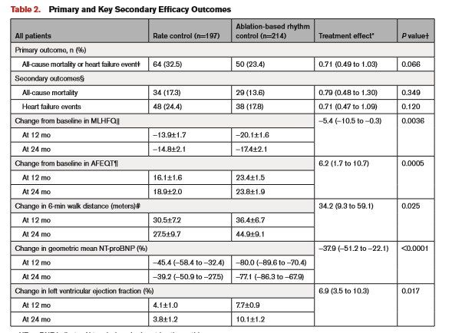

Slide 29
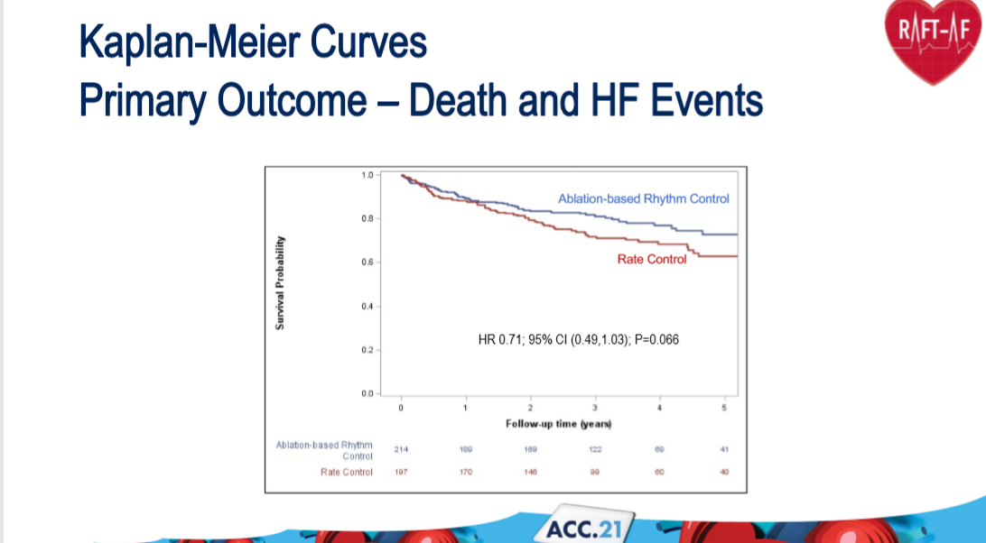

Slide 30
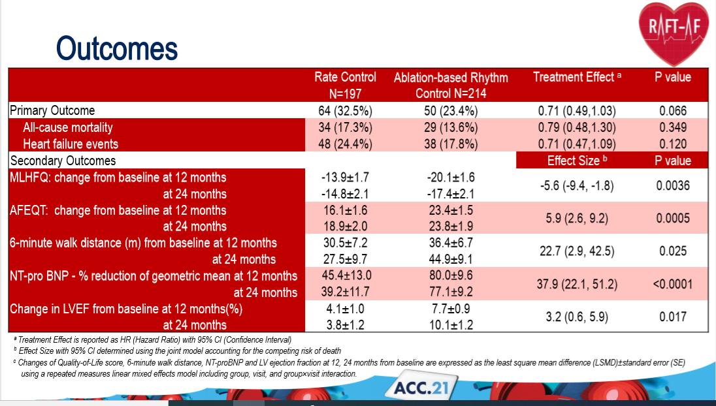

Slide 31
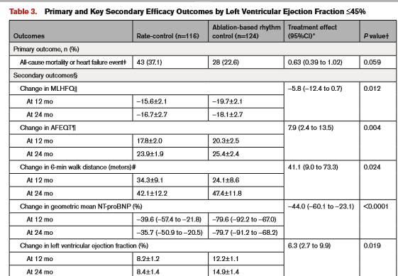

Slide 32
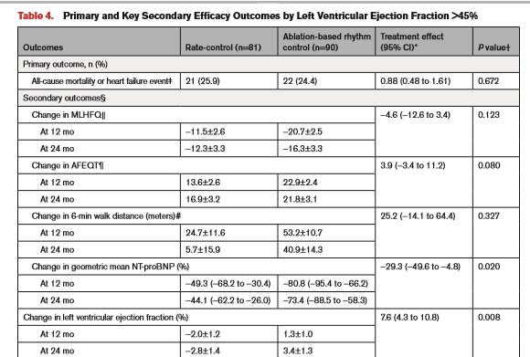

Slide 33
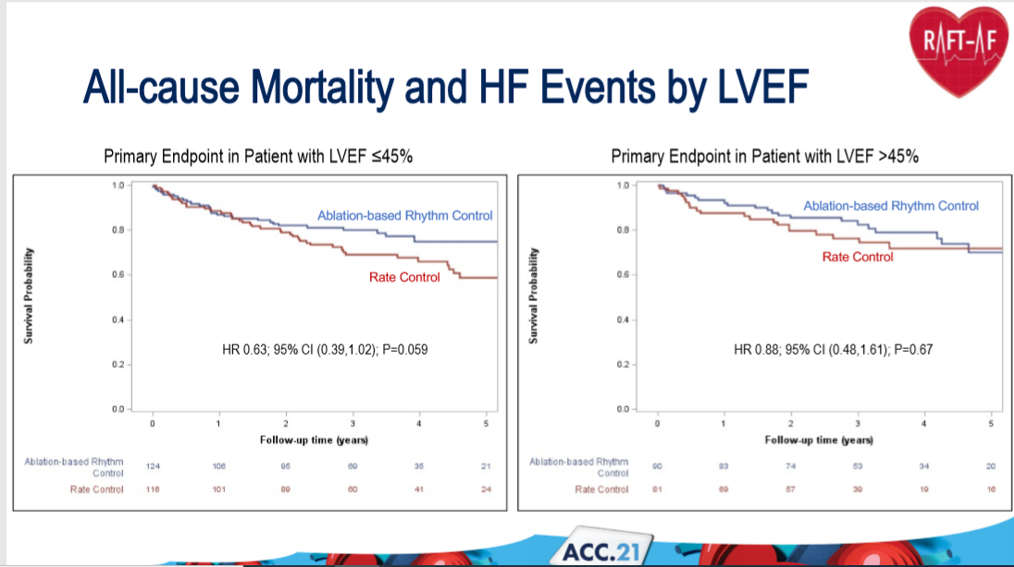

Slide 34
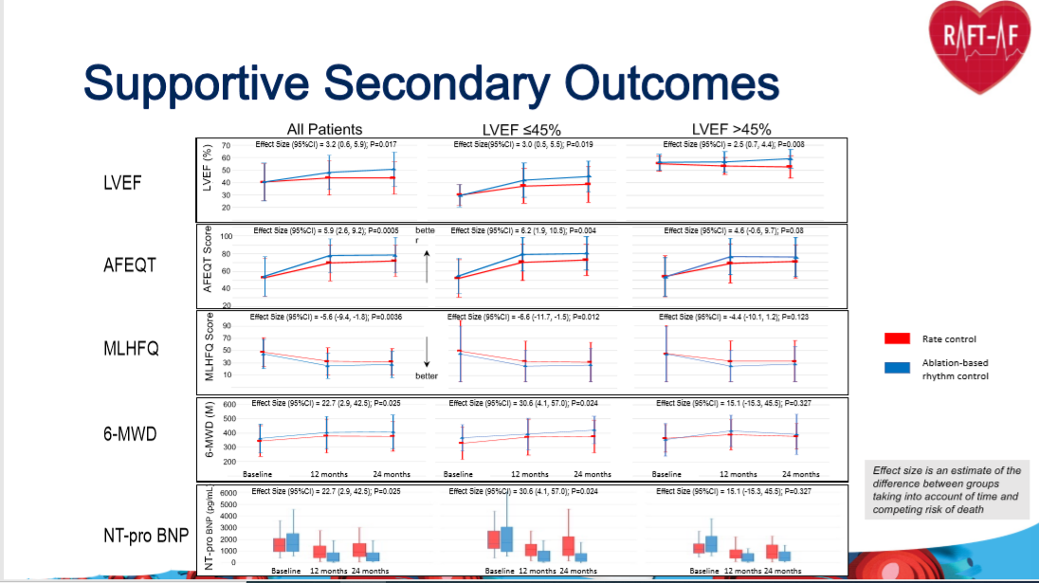

Slide 35
Subgroup analysis
Prespecified analysis of primary outcome by LVEF< 45% and > 45%.
There was no diffrence in quality of life and 6 minute walk distance for patient with LVEF > 45% between treatment strategies.
However NT proBNP decreased in ablation based rhythm control group,and there was an increase in LVEF overtime with ablation based rhythm control.
Analysis of AF type which was stratified demonstrated a greater effect in the paroxysmal and early persistent AF group for ablation based rhythm control as compared with persistent AF ( HR 0.68)
Analysis by sex demonstrated a greater effects in women compared with men( HR 0.42)

Slide 36
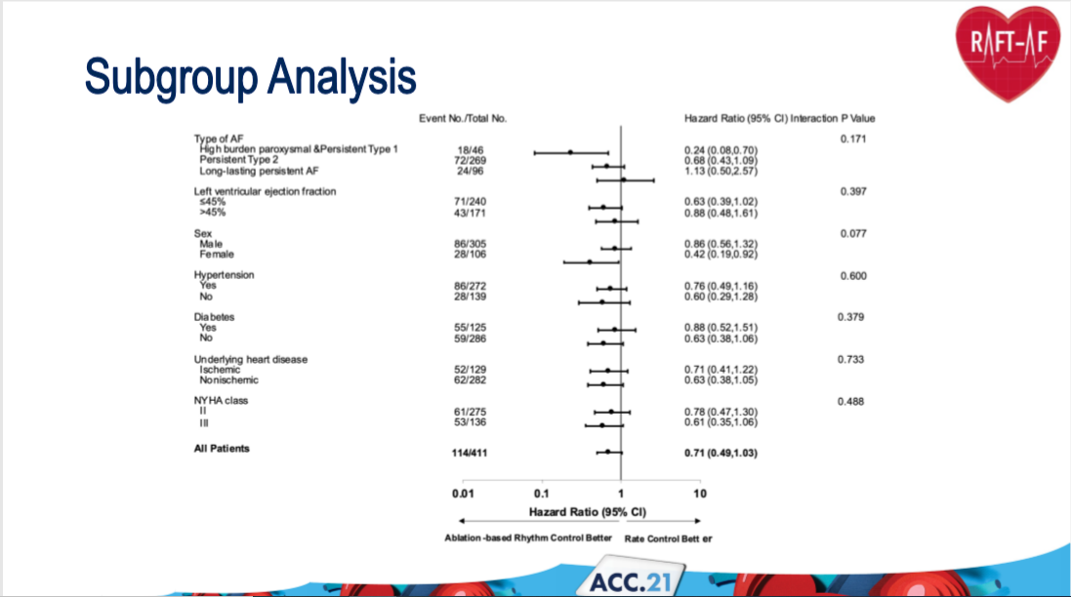

Slide 37
Adverse events
> 1 serious adverse events were 102 in ablation based rhythm control group and 99 in rate control group.
Ablation related serious adverse events includes, 1 patient with atrioesophageal fistula that led to death, 6 pericardial effusion needs pericardiocentesis, 8 major and 5 minor bleeding.
In rate control group 4 patients experienced bradycardia and 1 patient had amiadrone induced toxicity.
10 patients had strokes, 5 in each group.

Slide 38
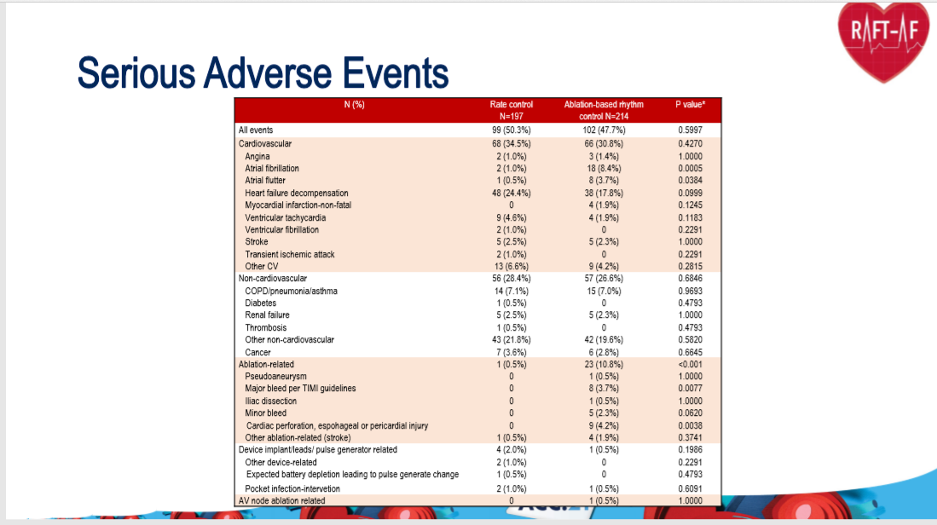

Slide 39
Discussion
Ablation based rhythm control did not significantly affect the primary composite outcome compared with rate control.
Patient in ablation based control group had greater improvement in left ventricular function , improvement in quality of life and reduced NT pro BNP.
The diffrential occurrence of primary outcome events was realized only after 18 months of follow up.
Previous studies( PABA-CHF ) and CASTLE-AF) have focused on surrogate measures of HF such as LVEF and maximal oxygen consumption or measured AF recurrences.

Slide 40
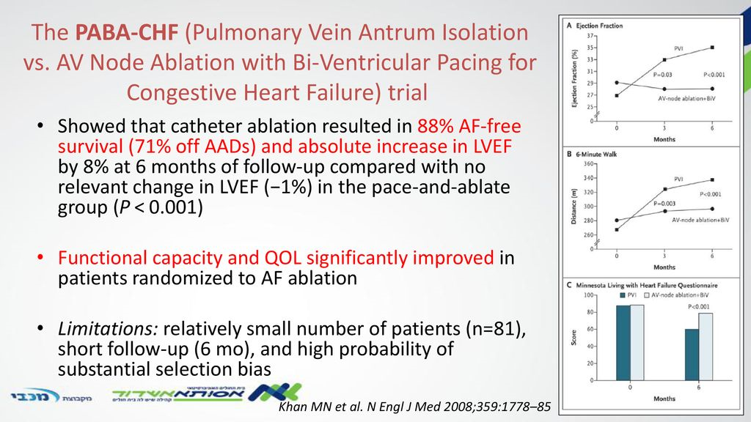

Slide 41
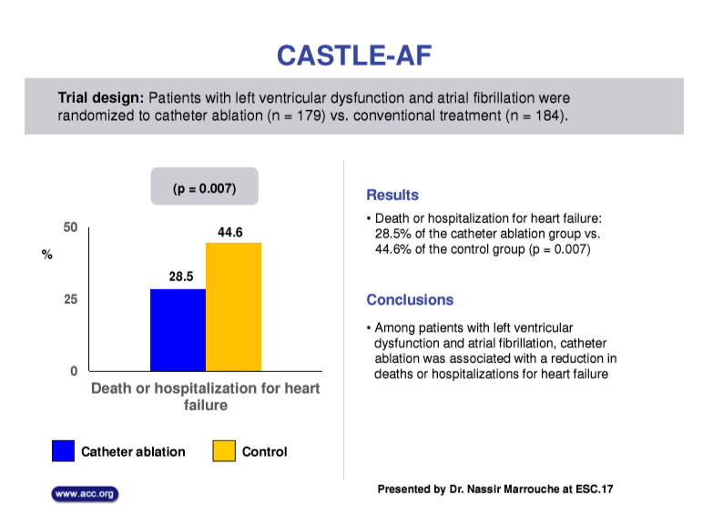

Slide 42
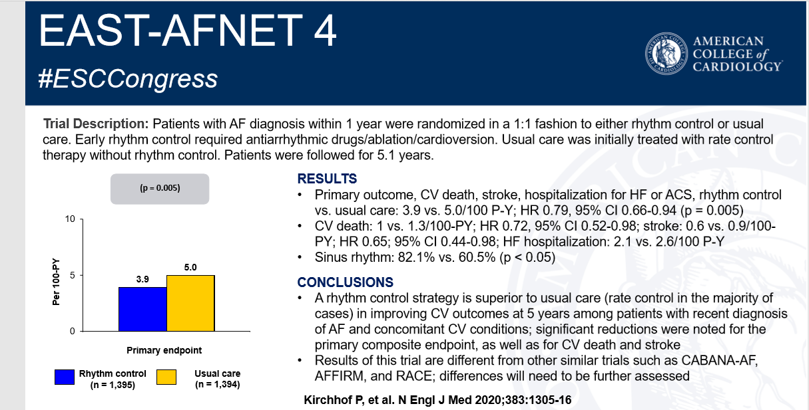

Slide 43
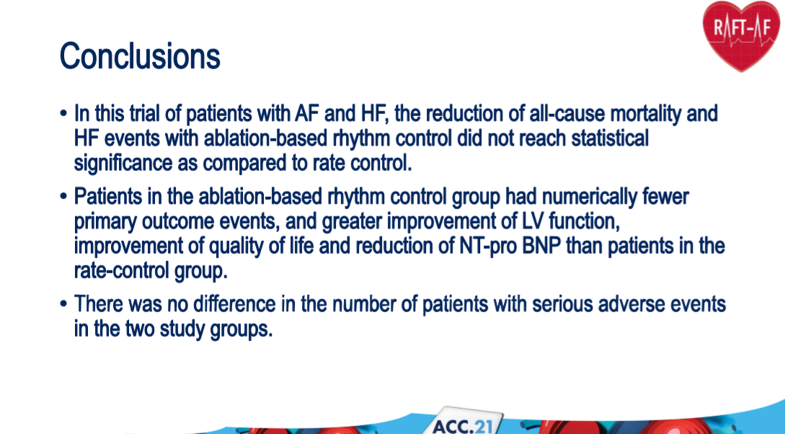

Slide 44
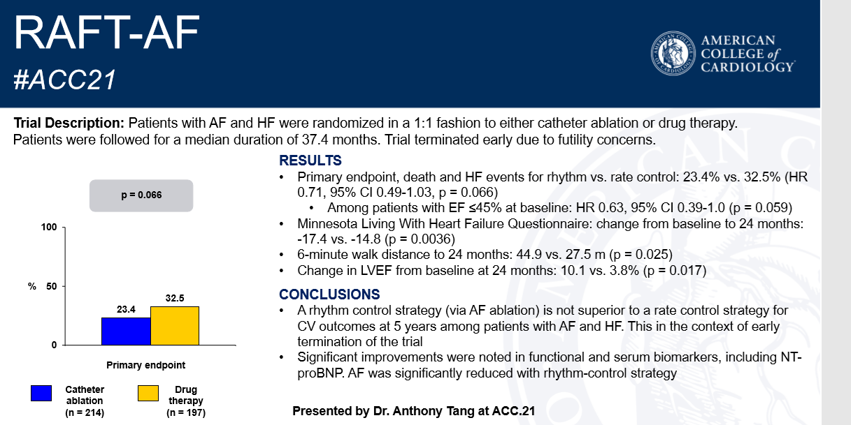

Slide 45
THANK YOU

Slide 46
HAZARD RATIO
survival analysis, the hazard ratio (HR) is the ratio of the hazard rates corresponding to the conditions described by two levels of an explanatory variable.

Slide 47
The hazard ratio is the ratio of (chance of an event occurring in the treatment arm)/(chance of an event occurring in the control arm) .
The HR has also been defined as, the ratio of (risk of outcome in one group)/(risk of outcome in another group), occurring at a given interval of time .
In the situation where the hazard for an outcome is exactly twice in Group A than in Group B, the value of the hazard ratio can be either 2.0 or 0.5.
The result of the calculation (whether HR=2.0 or 0.5) depends on whether the investigator chooses to calculate the ratio of hazards for (Group A)/(Group B) or, alternatively, to calculate the ratio of hazards for (Group B)/(Group A

Slide 48
